Slide 1
Overview:
Wisconsin Healthcare-Associated Infections in
Long-Term Care Coalition
UTI Toolkit

Slide 2


UTI Toolkit – Module 1
Narration by:
Brenda J. Ryther, RN, MSN
Nurse Researcher
University of Wisconsin-Madison
Content developed in partnership with the Wisconsin
Healthcare-Associated Infections in Long-Term Care Coalition
Funding for this project was provided by the Wisconsin Partnership Program at the UW School of Medicine and Public Health

Slide 3
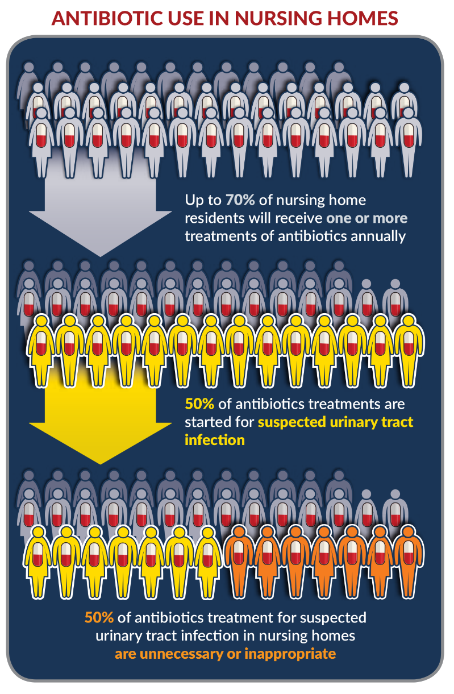
The Problem

Slide 4
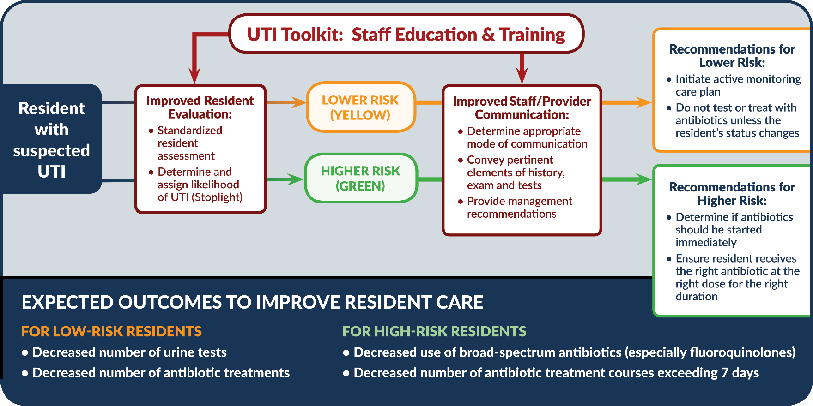
Toolkit Objectives

Slide 5
WI HAI in LTC Coalition
UTI Toolkit
The UTI Toolkit is comprised of 5 modules. Content includes presentations, resources and references to help nursing home staff improve the management of suspected UTIs.
  Overview & Rationale
  UTI Prevention
  Urine Testing
  UTI Treatment
  Quality Improvement

Slide 6
Overview and Rationale
This module is organized into three sections.
  Background and overview of the Wisconsin Urinary Tract Infection (UTI) Toolkit.
  Clinical rationale for antibiotic stewardship.
  Related regulatory information.

Slide 7
How to Prevent CAUTI
This module is organized into three sections.
  Background and risk factors for indwelling urinary catheter use and CAUTI.
  Appropriate indications and alternatives for indwelling catheter use.
  Indwelling catheter insertion and maintenance.

Slide 8
When to Test a Urine Specimen
This module is organized into four sections.
  Urinary tract infections, definitions and signs/symptoms.
  Introduction to the UTI Stoplight Tool and When to Test Urine-Nursing Tool.
  Practical application of the When to Test Urine-Nursing Tool to case studies.
  Suggested educational plan for implementing the tools and resources.

Slide 9
When and How to Treat a UTI
This module is organized into four sections.
  Clinical decision about when to treat a suspected urinary tract infection and the five moments of antibiotic decision-making.
  Basic principles related to initiating treatment, along with guidance about empiric treatment of uncomplicated and complicated urinary tract infection.
  Opportunities to modify existing antibiotic therapy, including antibiotic timeout.
  Collaborative role of the pharmacist in antibiotic stewardship and establishing a Collaborative Practice Agreement.

Slide 10
Quality Improvement
This module includes presentations and additional resources.
  Preparing for Successful Organizational Change
  Coaching Change Through Data-Driven Teamwork
  Sustainability of Organizational Change
  Sustainability Planning
  Antibiotic Stewardship, Antibiograms, etc.

Slide 11
Thank You!

