Slide 1
UTI Toolkit – Module 1
The Clinical Rationale for Improving the Management of UTIs in Nursing Homes

Slide 2


UTI Toolkit – Module 1
Narration by:
Christopher J. Crnich, MD PhD
Chief of Medicine, William S. Middleton Memorial VA Hospital
Associate Professor of Medicine, University of Wisconsin-Madison
Content developed in partnership with the Wisconsin
Healthcare-Associated Infections in Long-Term Care Coalition
Funding for this project was provided by the Wisconsin Partnership Program at the UW School of Medicine and Public Health

Slide 3
Outline
Frequency of Inappropriate Antibiotic Use in Nursing Homes
Resident-Level Risks of Antibiotic Therapy
  Adverse Drug Events
  Clostridium difficile infection
  Future antibiotic-resistant infections
Facility-Level Risks of Antibiotic Therapy
  Resident-to-Resident Spread of Antibiotic Resistance
  Regulatory issues (see “The Regulatory Rationale for Improving the Management of UTIs in Nursing Homes” presentation)
Why Focus on Urinary Tract Infection?

Slide 4
Outline
Frequency of Inappropriate Antibiotic Use in Nursing Homes
Resident-Level Risks of Antibiotic Therapy
  Adverse Drug Events
  Clostridium difficile infection
  Future antibiotic-resistant infections
Facility-Level Risks of Antibiotic Therapy
  Resident-to-Resident Spread of Antibiotic Resistance
  Regulatory issues (see “The Regulatory Rationale for Improving the Management of UTIs in Nursing Homes” presentation)
Why Focus on Urinary Tract Infection?

Slide 5
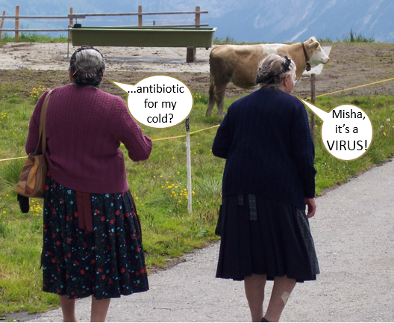
25-80% of Antibiotic Use in Nursing Homes (NHs) is Inappropriate
Zimmer et al. J Am Geriatr Soc 1986; 34(10): 703-10
Katz et al. Arch Intern Med 1990; 150(7): 1465-8
Warren et al. J Am Geriatr Soc 1991; 39(10): 963-72
Pickering et al. J Am Geriatr Soc 1994; 42(1): 28-32
Loeb et al. J Gen Intern Med 2001; 16(6): 376-83
Vergidis et al. 2011; J Am Geriatr Soc 59(6): 1093-8

Slide 6
Broad-Spectrum Antibiotic Use in Wisconsin Nursing Homes is Common
Broad-spectrum agents account for over half (51%) of antibiotic use in Wisconsin NHs (Figure).
Fluoroquinolones are the most frequently prescribed class (27% of all antibiotic days)
Broad Agents: fluoroquinolones, beta-lactam/beta-lactamase inhibitors (e.g., amoxicillin-clavulanate), 2nd & 3rd generation cephalosporins, macrolides, & carbapenems
Narrow Agents: Trimethoprim-sulfamethoxazole, nitrofurantoin, tetracyclines, 1st generation cephalosporins, penicillins
7. Crnich et al. Society for Healthcare Epidemiology of America 2019, Boston, MA

Slide 7
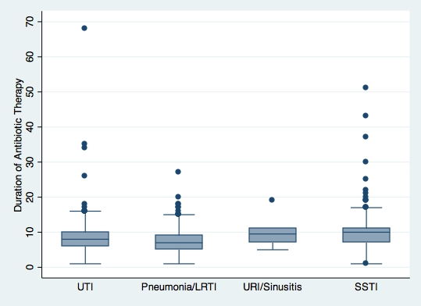
Prolonged Antibiotic Courses are Common in Wisconsin NHs
Half of antibiotic treatment courses initiated in Wisconsin NHs are prescribed for more than seven days (Figure).⁸
20% of overall antibiotic use in NHs could be eliminated by shortening treatment courses to 7 days or less even if there was no change in the total number of antibiotic starts!⁹
(n = 353)
(n = 194)
(n = 12)
(n = 162)
  Crnich; Unpublished data
  Daneman et al. JAMA Intern Med 2013

Slide 8
Outline
Frequency of Inappropriate Antibiotic Use in Nursing Homes
Resident-Level Risks of Antibiotic Therapy
  Adverse Drug Events
  Clostridium difficile infection
  Future antibiotic-resistant infections
Facility-Level Risks of Antibiotic Therapy
  Resident-to-Resident Spread of Antibiotic Resistance
  Regulatory issues (see “The Regulatory Rationale for Improving the Management of UTIs in Nursing Homes” presentation)
Why Focus on Urinary Tract Infection?

Slide 9
Antibiotics are a Leading Cause of Adverse Drug Events (ADEs) in Nursing Homes (NHs)
Independent Risk Factors of ADEs¹¹
Risk Factor | OR | 95% CI
New admission | 2.8 | (1.5 – 5.2)
No. of Scheduled Medications
<5 | 1.0 | (referent)
5-6 | 2.0 | (1.2 – 3.2)
7-8 | 2.8 | (1.7 – 4.7)
≥9 | 3.3 | (1.9 – 5.6)
Current Medications
Antibiotic | 4.0 | (2.5 – 6.2)
Antipsychotic | 3.2 | (2.1 – 4.9)
Antidepressant | 1.5 | (1.1 – 2.3)
Supplements | 0.4 | (0.3 – 0.6)
20% of all ADRs
Handler
2006 ¹³
Gurwitz
2000 ¹⁰
Gurwitz
2005 ¹²
10. Gurwitz et al. Am J Med 2000 11. Field et al. Arch Intern Med 2001
12. Gurwitz et al. Am J Med 2005 13. Handler et al. Am J Geriatr Pharmacother 2006

Slide 10
Antibiotic Use is Driving CDI in NHs
512 Records Screened
Original McGeer Criteria-1991 (at least 3 of the following)
  Temperature ≥ 38°C
  N/⬆ burning/frequency/urgency
  New flank/suprapubic pain/tenderness
  Change in character of urine
    Blood/smell/sediment
    Pyuria/hematuria
  Worsening mental or functional status
Inappropriate therapy (independent of decision to start)
  Treatment initiated empirically (before culture) in only 27/96 (28%) of residents
  Empiric antibiotic inappropriate in 56% of cases (FQ when TMP/SMX or NFT reasonable)
  Dosage (High [21%] / Low [13%] / CI [12%])
  Duration (Short [3%] / Long [67%])
172 Cases with Abnormal UA
McGeer (+)
(n = 26)
McGeer (-)
(n = 146)
Abx (+)
(n = 26)
Abx (+)
(n = 70)
Abx (-)
(n = 76)
Risk of CDI in Treated vs. Untreated
OR = 8.5 (1.7 – 42.2)
CDI (+)
(n = 11)
14. Rotjanapan et al. Arch Intern Med 2011

Slide 11
Antibiotic Treatment (even when appropriate) Carries Future Risk of Antibiotic Resistance for the Individual
Costelloe et al. BMJ 2010
Drinka et al. JAMDA 2013

Slide 12
Infections Caused by Antibiotic-Resistant Bacteria Increase Resident Risk of Death
Attributable Mortality of Antibiotic-Resistant Infections
25.0
22.9
OR (red) and 95% CIs (blue)
8.0
7.0
6.0
5.0
4.0
3.0
2.0
1.0
0.5
MRSA
(BSI)
MRSA
(SSI)
Resistant
PSAE
3rd Gen-R
Entero-bacter
ESBL
E. coli
CRE
17. Carmeli et al. Arch Intern Med 1999 19. Engemann et al. Clin Infect Dis 2003 21. Cosgrove et al. Clin Infect Dis 2003
18. Cosgrove et al. Arch Intern Med 2002 20. Lautenbach et al. Clin Infect Dis 2001 22. Patel et al. Infect Control Hosp Epidemiol 2008

Slide 13
Outline
Frequency of Inappropriate Antibiotic Use in Nursing Homes
Resident-Level Risks of Antibiotic Therapy
  Adverse Drug Events
  Clostridium difficile infection
  Future antibiotic-resistant infections
Facility-Level Risks of Antibiotic Therapy
  Fallout to other residents
  Resident-to-Resident Spread of Antibiotic Resistance
  Regulatory issues
Why Focus on Urinary Tract Infection?

Slide 14
Antibiotic Fallout
Setting:
607 NHs in Ontario; categorized into tertiles of antibiotic use (low, medium, high)
110,000 NH residents followed for 2 years.
Study Endpoint: Combined rate of C. difficile, diarrhea/gastroenteritis, infection with antibiotic-resistant bacteria and adverse drug event (ADE)
Results:
~83,000 NH residents received an antibiotic & ~27,000 residents did not receive an antibiotic
Risk of experiencing the combined endpoint was 24% higher in high-use NHs, even if the resident never received an antibiotic (Figure)
  23. Daneman et al. JAMA Intern Med 2015
  24. Mody & Crnich et al. JAMA Intern Med 2015

Slide 15
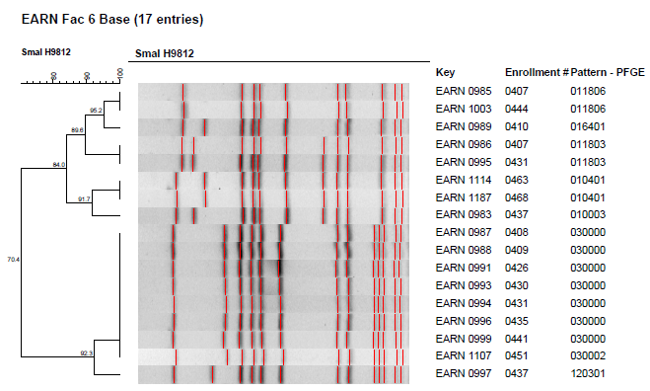
Antibiotic-Resistant Bacteria Spread Easily in the Nursing Home Environment
Strong evidence of resident-to-resident spread in NHs.
  50% of MRSA isolates recovered from Wisconsin NHs are genetically identical
  >85% of the MRSA isolates from NH residents who entered the NH negative but subsequently became colonized during their stay in the NH are genetically identical to strains recovered from other residents
14 of the 17 MRSA isolates recovered from residents in this nursing home were found to be genetically identical by pulsed-field gel electrophoresis (PFGE – a commonly employed genetic finger-printing technique)
25. Crnich et al. 2013 Am Soc Microbiol Scientific Meeting

Slide 16
Treating Antibiotic Resistant Infections is More Costly to Nursing Homes
26. Capitano et. al. J Am Geriatr Soc 2003

Slide 17
Outline
Frequency of Inappropriate Antibiotic Use in Nursing Homes
Resident-Level Risks of Antibiotic Therapy
  Adverse Drug Events
  Clostridium difficile infection
  Future antibiotic-resistant infections
Facility-Level Risks of Antibiotic Therapy
  Resident-to-Resident Spread of Antibiotic Resistance
  Regulatory issues (refer to “The Regulatory Rationale for Improving the Management of UTIs in Nursing Homes” presentation)
Why Focus on Urinary Tract Infection?

Slide 18
Suspected UTI
Accounts for 24% of all infections in older adults.
Accounts for 12-25% of LTCF infections.
Most common cause of bacteremia in LTCF.
Responsible for 20-60% of antimicrobial use in LTCF.

Slide 19
Up to 75% of the Cases of Suspected UTI are Actually Asymptomatic Bacteriuria (ASB)
Definition: (+) urine culture in the absence of (“specific”) symptoms
Prevalence
  Community: 6 – 17%
  Institutionalized: 19 – 57%
Treatment of ASB
  Does not reduce episodes of symptomatic UTI ^{28, 29, 30, 32}
  Promotes resistance ^{28, 30}
  Increases risk of C. difficile ³⁰
  Does not reduce mortality ^{29, 30, 31}
27. Warren et al., JAMA 1982 29. Nicolle et al. Am J Med 1987 31. Ouslander et al. Ann Intern Med 1995
28. Nicolle et al. N Engl J Med 1983 30. Abrutyn et al. Ann Intern Med 1994

Slide 20
Providers Don’t Think They Are Treating Asymptomatic Bacteriuria
UTI, as well as many other conditions, can result in resident change-in-condition (Table)
Non-localizing signs often (>60%) the only reason provided by clinicians when asked why they suspect UTI
There is no evidence that behavior change, falls, anorexia, or functional status associated with UTI
D | Drugs Dementia Discomfort | BEERS Criteria (e.g., anticholinergic, benzodiazepines, hypnotics) OR dose change Dementia Lewy bodies: Fluctuations in alertness and attention Pain
E | Eyes, ears, environment | Sensory deprivation; vulnerability to environment
L | Low oxygen states | Myocardial infarction, stroke, pulmonary embolus
I | Infection | Pneumonia, sepsis, symptomatic UTI
R | Retention | Urinary retention, constipation
I | Ictal states | Seizure disorder
U | Underhydration/ nutrition | Dehydration
M | Metabolic Causes | Low or high blood sugar, sodium abnormalities
S | Subdural hematoma | Head trauma
32. Nace et al. J Am Med Dir Assoc 2014 33. Finucane et al. J Am Geriatr Soc 2017

Slide 21
Why?
Risk Aversion
  Frail residents can get sick quickly
  Family member pressure
  Nursing staff pressure
Uncertainty
  Some NH residents are non-verbal (but most are)
  Some NH residents do not mount fever (but most do)
  UTI can manifest with non-localizing symptoms (although most have additional findings)
Myths Perpetuated During Training Become Habits
  Falls and behavior change = UTI
  Abnormal UA = UTI
  Positive Culture = UTI

Slide 22
Dipstick → UA → Urine culture → Antibiotic Prescription
Testing the urine is one of the easiest things we do in the NH (what if it was as hard as getting a respiratory specimen?)
Automating urine testing is done in many facilities for the sake of efficiency
  Standing orders for dipstick and urinalyses
  Pan-“everything” workups
Ignoring culture results is hard (particularly if you do not know the resident)
34. Crnich Ann Long Term Care 2014

Slide 23
Conclusions
Inappropriate antibiotic use is common in NHs.
Inappropriate antibiotic use causes significant resident harm and increases NH operating costs.
UTIs account for a majority of the inappropriate antibiotic use in NHs.
Reducing unnecessary urine testing can reduce inappropriate antibiotic use.
Reducing spectrum and duration of antibiotic therapy are other promising strategies for reducing antibiotic pressure in NHs.

