Slide 1
When To Test?
When to Submit a Urine Specimen for Testing?

Slide 2


UTI Toolkit – Module 3
Narration by:
Anna Eslinger, RN
Infection Preventionist
Marshfield Medical Center - Eau Claire
Content developed in partnership with the Wisconsin
Healthcare-Associated Infections in Long-Term Care Coalition
Funding for this project was provided by the Wisconsin Partnership Program at the UW School of Medicine and Public Health

Slide 3
Objectives
Reinforce the benefits of reducing unnecessary urine testing
Introduce the “UTI Stoplight Tool”
Introduce the “When To Test-Nursing Tool”
Briefly describe how to manage residents who have isolated, non-specific geriatric symptoms (low probability of UTI)
Nace, et.al. JAMDA 2014; 15(2): 133-39

Slide 4
Urine Cultures Are a Common Trigger for Antibiotic Use in Nursing Homes
It is hard for providers to ignore a positive urine culture, even when the resident does not exhibit specific UTI symptoms.
Nearly 80% of antibiotic courses initiated for treatment of UTI are started after urine cultures are resulted (Figure 1).
A majority of these residents had asymptomatic bacteriuria and did not exhibit any localizing signs or symptoms of UTI.
Phillips et al. BMC Geriatr 2012; 12: 73

Slide 5
Potential Harm Created by Sending Unnecessary Urine Tests
Miss Other Important Diagnoses
Medication Side Effect
Dehydration
Uncontrolled Pain
Constipation
Sleep Deprivation
Hypoglycemia
Electrolyte Abnormality
Low O2 / High CO2
Stroke/Seizure
Overuse Antibiotics Which Can Cause a Variety of Resident Harms*
1
2
20% of all adverse drug events (ADEs) in nursing homes caused by antibiotics
Antibiotic-associated ADEs are one of the most common reasons for transfer to ER
ADE
C. difficile infection (CDI) is a life-threatening intestinal disease caused by antibiotics
12% of nursing home residents treated inappropriately for UTI develop CDI
CDI
~50% of nursing residents are colonized with Abx-resistant organisms (AROs)
Antibiotic exposure is the single most important risk factor for ARO colonization
ARO
* See “Clinical Rationale” in Module 1 for more detail.

Slide 6
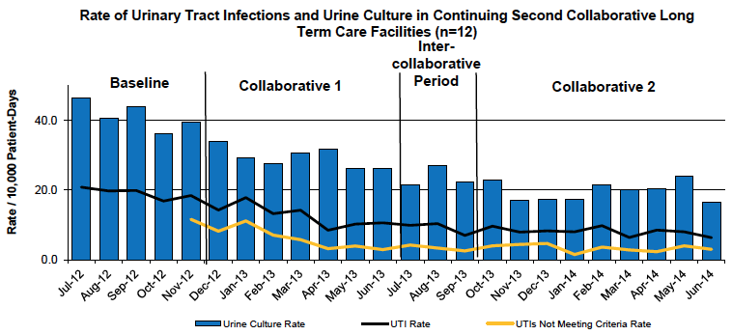
Benefits of Reducing Unnecessary Urine Culture Testing
12 Massachusetts nursing homes participated in a QI project to reduce urine testing in residents who presented with non-specific geriatrics symptoms (e.g., behavior change) and did not have other specific symptoms.
Urine culture and UTI treatment rates dropped significantly (Figure & Table).
Rates of Clostridium difficile improved but not to statistically significant degree (Table).
Figure: Impact of Reducing Urine Culture Testing
Measure | IRR (95% CI)
Urine Culture Rate | 0.47 (0.42 – 0.52)
UTI Rate | 0.42 (0.35 – 0.50)
C. difficile Rate | 0.85 (0.45 – 1.68)
Massachusetts Coalition for Patient Safety

Slide 7
UTI Stoplight Tool
Intended to help nursing staff determine if a resident experiencing a change-in-condition has a high probability of UTI (green light) or a lower probability of UTI (red and yellow light).
The tool has been incorporated into educational pamphlets as well as posters in order to make it readily available to staff and providers.
Nursing staff should be encouraged to specify their determination of the resident’s UTI probability during their initial communication with providers about a new resident change-in-condition.

Slide 8
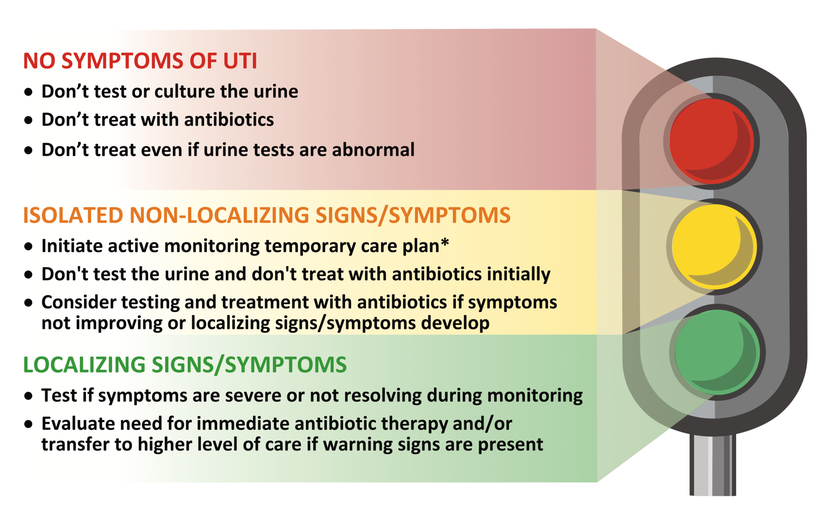
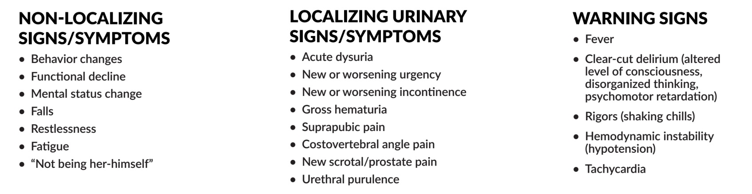

Slide 9
When To Test-Nursing Tool
The tool can be used to train nursing staff on how to assess their residents, what parts of the assessment to pay attention to and when they need to contact the provider*
The tool is intended to be used in conjunction with communication scripts that have been developed for different types of resident change in condition*
The tool may also be incorporated into handouts and poster reminders for nursing work spaces
*See Nursing Tool: Application to Case Studies and Development of Provider Communication Scripts in Module 3.

Slide 10
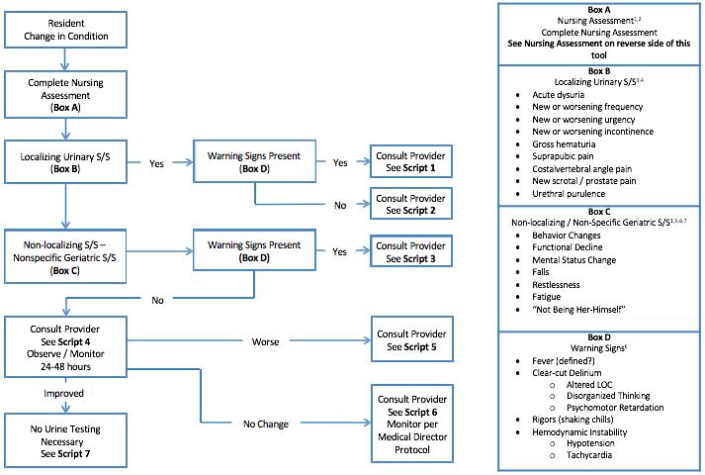
When To Test – Nursing Tool
Adapted from Crnich & Drinka. Ann Long Term Care 2014; July: 43-7

Slide 11
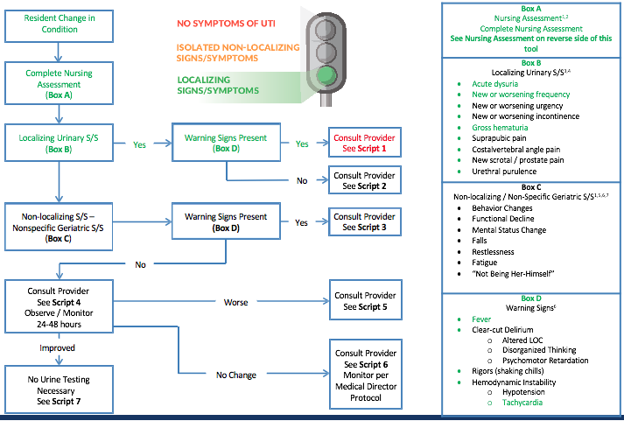
When To Test – Nursing Tool
Adapted from Crnich & Drinka. Ann Long Term Care 2014; July: 43-7

Slide 12
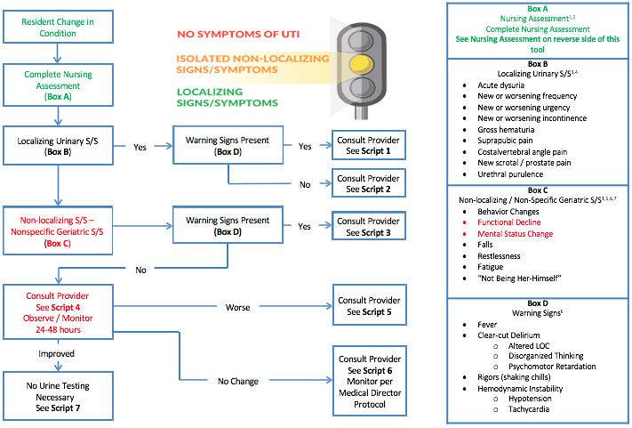
When To Test – Nursing Tool
Adapted from Crnich & Drinka. Ann Long Term Care 2014; July: 43-7

Slide 13
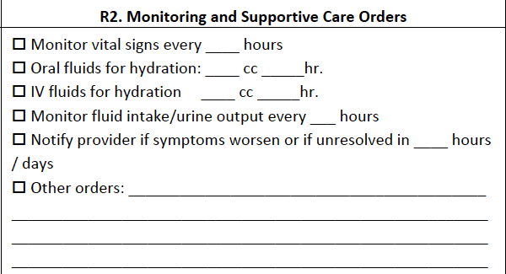
What is Active Monitoring?
Re-examining and measuring vital signs more frequently
Reviewing medications, bowel/bladder patterns, sleep patterns and social milieu to identify potential triggers
Promoting fluid intake (IV/PO) if there is concern for dehydration
Contacting provider at as needed and with development of localizing signs/symptoms or warning signs
Obtaining additional labs (not urine tests though!)
Example: Temporary Care Plan Order set

Slide 14
Why Active Monitoring?
Rapidly detect any further deterioration that would require repeat conversation with provider and more aggressive intervention
Provide additional information that might help identify the cause of change in condition (e.g., constipation, inadequately managed pain, etc.)
Initiation of fluids may help correct dehydration which may be triggering the change in the first place
Provides a talking point for conversations with family that reassures them that staff are keeping a very close eye on their loved one

Slide 15
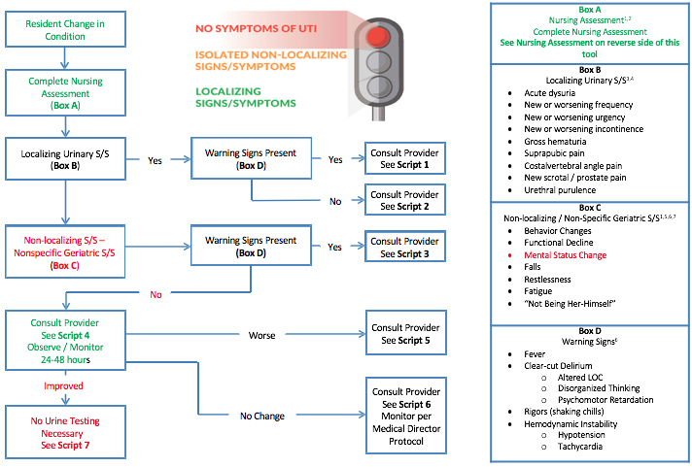
When To Test – Nursing Tool
Adapted from Crnich & Drinka. Ann Long Term Care 2014; July: 43-7

Slide 16
Summary – When to Test
The WI UTI Toolkit can be employed to create a shared understanding of when to perform testing on urine samples
Test the urine only when there are specific urinary tract signs or symptoms
Develop/adopt an active monitoring temporary care plan to help nursing staff structure the management of residents who have a less concerning change in condition

