Slide 1
When and How to Treat UTI
Section 1: When to Treat

Slide 2
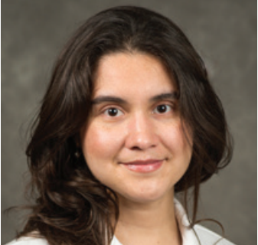

UTI Toolkit – Module 4a
Narration by:
Paula Hardgrove, MD CMD
Wisconsin Association of Medical Directors
Content developed in partnership with the Wisconsin
Healthcare-Associated Infections in Long-Term Care Coalition
Funding for this project was provided by the Wisconsin Partnership Program at the UW School of Medicine and Public Health

Slide 3
There are Five Moments of
Antibiotic Decision-Making
1
Should I Test?
2
Should I Treat?
3
How do I Treat?
4
Should I Change/Modify?
5
How Long do I Treat?

Slide 4
There are Five Moments of
Antibiotic Decision-Making
1
Should I Test?
2
Should I Treat?
3
How do I Treat?
4
Should I Change/Modify?
5
How Long do I Treat?

Slide 5
There are Five Moments of
Antibiotic Decision-Making
1
Should I Test?
2
Should I Treat?
3
How do I Treat?
4
Should I Change/Modify?
5
How Long do I Treat?
See Module 3

Slide 6
There are Five Moments of
Antibiotic Decision-Making
1
Should I Test?
2
Should I Treat?
3
How do I Treat?
4
Should I Change/Modify?
5
How Long do I Treat?

Slide 7
When to test?
It’s the same clinical decision
When to Treat?

Slide 8
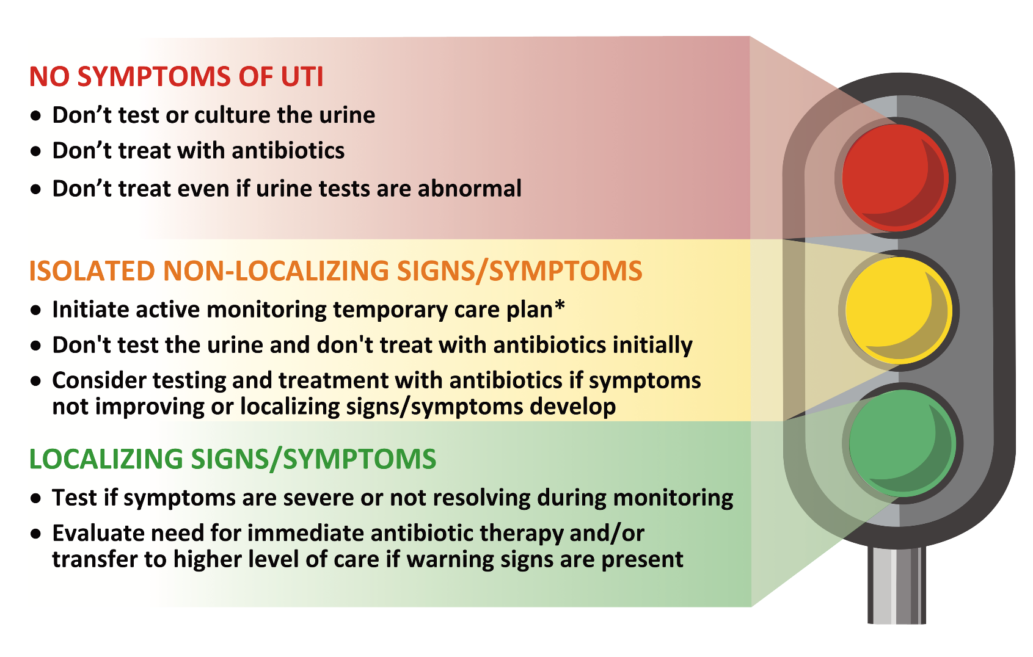
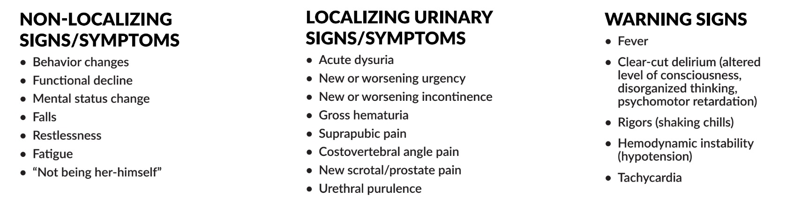
* See slide #20 for an example of an active monitoring temporary care plan.

Slide 9
Resident Change in Condition
Yes
Empiric Therapy for UTI
1
Localizing Urinary Signs/Symptoms?
Yes
Obtain
UA & UCx
Warning
Signs?
No
Target Therapy Based on UCx
No – consider withholding treatment until UCx results back
2
Non-Urinary Signs/Symptoms?
Yes
Work-up/Treat Other Cause
No
3
Warning Signs?
Yes
Obtain
UA & UCx
Empiric Therapy for UTI
Target Therapy Based on UCx
No
No Change / Worse
4
Resident Status after 48h of Observation?
Non-Urinary
Signs/Symptoms?
Yes
Work-up/Treat Other Cause
Improved
No
No Antibiotic
Necessary
Obtain
UA & Ucx
Consider Empiric Rx of UTI
Target Therapy Based on Cx
1 Crnich and Drinka. Ann Long Term Care 2014

Slide 10
Resident Change in Condition
Yes
Empiric Therapy for UTI
1
Localizing Urinary Signs/Symptoms?
Yes
Obtain
UA & UCx
Warning
Signs?
No
Target Therapy Based on UCx
No – consider withholding treatment until UCx results back
2
Non-Urinary Signs/Symptoms?
Yes
Work-up/Treat Other Cause
No
3
Warning Signs?
Yes
Obtain
UA & UCx
Empiric Therapy for UTI
Target Therapy Based on UCx
No
No Change / Worse
4
Resident Status after 48h of Observation?
Non-Urinary
Signs/Symptoms?
Yes
Work-up/Treat Other Cause
Improved
No
No Antibiotic
Necessary
Obtain
UA & Ucx
Consider Empiric Rx of UTI
Target Therapy Based on Cx
1 Crnich and Drinka. Ann Long Term Care 2014

Slide 11
Resident Change in Condition
Yes
Empiric Therapy for UTI
1
Localizing Urinary Signs/Symptoms?
Yes
Obtain
UA & UCx
Warning
Signs?
No
Target Therapy Based on UCx
No – consider withholding treatment until UCx results back
2
Non-Urinary Signs/Symptoms?
Yes
Work-up/Treat Other Cause
No
3
Warning Signs?
Yes
Obtain
UA & UCx
Empiric Therapy for UTI
Target Therapy Based on UCx
No
No Change / Worse
4
Resident Status after 48h of Observation?
Non-Urinary
Signs/Symptoms?
Yes
Work-up/Treat Other Cause
Improved
No
No Antibiotic
Necessary
Obtain
UA & Ucx
Consider Empiric Rx of UTI
Target Therapy Based on Cx
1 Crnich and Drinka. Ann Long Term Care 2014

Slide 12
Resident Change in Condition
Yes
Empiric Therapy for UTI
1
Localizing Urinary Signs/Symptoms?
Yes
Obtain
UA & UCx
Warning
Signs?
No
Target Therapy Based on UCx
No – consider withholding treatment until UCx results back
2
Non-Urinary Signs/Symptoms?
Yes
Work-up/Treat Other Cause
No
3
Warning Signs?
Yes
Obtain
UA & UCx
Empiric Therapy for UTI
Target Therapy Based on UCx
No
No Change / Worse
4
Resident Status after 48h of Observation?
Non-Urinary
Signs/Symptoms?
Yes
Work-up/Treat Other Cause
Improved
No
No Antibiotic
Necessary
Obtain
UA & Ucx
Consider Empiric Rx of UTI
Target Therapy Based on Cx
1 Crnich and Drinka. Ann Long Term Care 2014

Slide 13
Resident Change in Condition
Yes
Empiric Therapy for UTI
1
Localizing Urinary Signs/Symptoms?
Yes
Obtain
UA & UCx
Warning
Signs?
No
Target Therapy Based on UCx
No – consider withholding treatment until UCx results back
2
Non-Urinary Signs/Symptoms?
Yes
Work-up/Treat Other Cause
If a resident has:
Localizing urinary symptoms AND
Warning signs*
START ANTIBIOTICS IMMEDIATELY
(change antibiotics based on results of urine culture when available)
* Warning Signs
No
Fever
Clear-cut delirium (altered level of consciousness, disorganized thinking, psychomotor retardation)
Rigors (shaking chills)
Hemodynamic instability (hypotension)
Tachycardia
3
Warning Signs?
Yes
Obtain
UA & UCx
Empiric Therapy for UTI
Target Therapy Based on UCx
No
No Change / Worse
4
Resident Status after 48h of Observation?
Non-Urinary
Signs/Symptoms?
Yes
Work-up/Treat Other Cause
Improved
No
No Antibiotic
Necessary
Obtain
UA & Ucx
Consider Empiric Rx of UTI
Target Therapy Based on Cx
1 Crnich and Drinka. Ann Long Term Care 2014

Slide 14
Resident Change in Condition
Yes
Empiric Therapy for UTI
1
Localizing Urinary Signs/Symptoms?
Yes
Obtain
UA & UCx
Warning
Signs?
No
Target Therapy Based on UCx
No – consider withholding treatment until UCx results back
2
Non-Urinary Signs/Symptoms?
Yes
Work-up/Treat Other Cause
No
3
Warning Signs?
Yes
Obtain
UA & UCx
Empiric Therapy for UTI
Target Therapy Based on UCx
No
No Change / Worse
4
Resident Status after 48h of Observation?
Non-Urinary
Signs/Symptoms?
Yes
Work-up/Treat Other Cause
Improved
No
No Antibiotic
Necessary
Obtain
UA & Ucx
Consider Empiric Rx of UTI
Target Therapy Based on Cx
1 Crnich and Drinka. Ann Long Term Care 2014

Slide 15
Resident Change in Condition
Yes
Empiric Therapy for UTI
1
Localizing Urinary Signs/Symptoms?
Yes
Obtain
UA & UCx
Warning
Signs?
No
Target Therapy Based on UCx
No – consider withholding treatment until UCx results back
2
Non-Urinary Signs/Symptoms?
Yes
Work-up/Treat Other Cause
If a resident has:
Localizing urinary symptoms ONLY
No Warning signs
CONSIDER WAITING FOR CULTURE RESULTS BEFORE STARTING ANTIBIOTICS
No
Benefits of Waiting
3
Warning Signs?
Yes
Obtain
UA & UCx
Generally safe
Avoids treatment with ineffective antibiotics (when resistance present)
Allows use of narrow spectrum antibiotics (because you know what you are treating)
Empiric Therapy for UTI
Target Therapy Based on UCx
No
No Change / Worse
4
Resident Status after 48h of Observation?
Non-Urinary
Signs/Symptoms?
Yes
Work-up/Treat Other Cause
Improved
No
No Antibiotic
Necessary
Obtain
UA & Ucx
Consider Empiric Rx of UTI
Target Therapy Based on Cx
1 Crnich and Drinka. Ann Long Term Care 2014

Slide 16
Resident Change in Condition
Yes
Empiric Therapy for UTI
1
Localizing Urinary Signs/Symptoms?
Yes
Obtain
UA & UCx
Warning
Signs?
No
Target Therapy Based on UCx
No – consider withholding treatment until UCx results back
2
Non-Urinary Signs/Symptoms?
Yes
Work-up/Treat Other Cause
No
3
Warning Signs?
Yes
Obtain
UA & UCx
Empiric Therapy for UTI
Target Therapy Based on UCx
No
No Change / Worse
4
Resident Status after 48h of Observation?
Non-Urinary
Signs/Symptoms?
Yes
Work-up/Treat Other Cause
Improved
No
No Antibiotic
Necessary
Obtain
UA & Ucx
Consider Empiric Rx of UTI
Target Therapy Based on Cx
1 Crnich and Drinka. Ann Long Term Care 2014

Slide 17
Resident Change in Condition
* Warning Signs
Yes
Empiric Therapy for UTI
Fever
Clear-cut delirium
Rigors
Hemodynamic instability (hypotension)
Tachycardia
1
Localizing Urinary Signs/Symptoms?
Yes
Obtain
UA & UCx
Warning
Signs?
No
Target Therapy Based on UCx
No – consider withholding treatment until UCx results back
2
Non-Urinary Signs/Symptoms?
Yes
Work-up/Treat Other Cause
No
3
Warning Signs?
Yes
Obtain
UA & UCx
Empiric Therapy for UTI
Target Therapy Based on UCx
No
If a resident has:
No localizing urinary symptoms AND
No evidence of infection elsewhere AND
Warning signs*
CULTURE/TREAT WITH ANTIBIOTICS
No Change / Worse
4
Resident Status after 48h of Observation?
Non-Urinary
Signs/Symptoms?
Yes
Work-up/Treat Other Cause
Improved
No
No Antibiotic
Necessary
Obtain
UA & Ucx
Consider Empiric Rx of UTI
Target Therapy Based on Cx
1 Crnich and Drinka. Ann Long Term Care 2014

Slide 18
Resident Change in Condition
Yes
Empiric Therapy for UTI
1
Localizing Urinary Signs/Symptoms?
Yes
Obtain
UA & UCx
Warning
Signs?
No
Target Therapy Based on UCx
No – consider withholding treatment until UCx results back
2
Non-Urinary Signs/Symptoms?
Yes
Work-up/Treat Other Cause
No
3
Warning Signs?
Yes
Obtain
UA & UCx
Empiric Therapy for UTI
Target Therapy Based on UCx
No
No Change / Worse
4
Resident Status after 48h of Observation?
Non-Urinary
Signs/Symptoms?
Yes
Work-up/Treat Other Cause
Improved
No
No Antibiotic
Necessary
Obtain
UA & Ucx
Consider Empiric Rx of UTI
Target Therapy Based on Cx
1 Crnich and Drinka. Ann Long Term Care 2014
Notes:
The individual elements of this integrated decision pathway will be discussed in later modules.

Slide 19
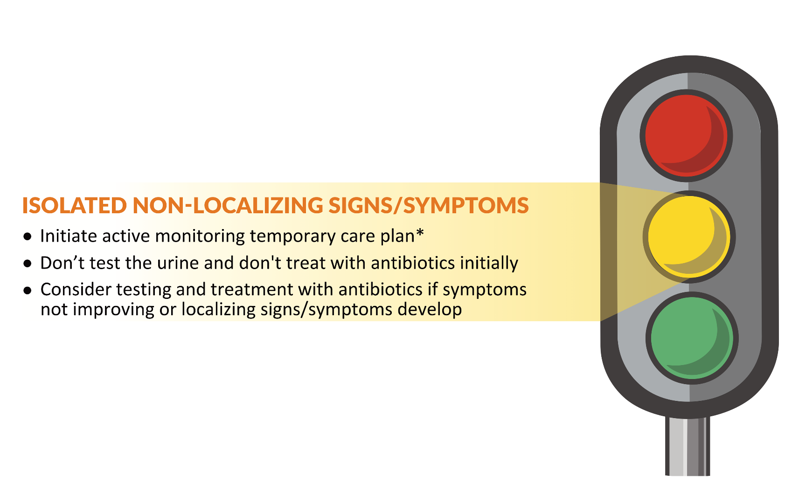
Isolated Non-Localizing Signs/Symptoms = Active Monitoring
NON-LOCALIZING SIGNS/SYMPTOMS
Behavior Changes
Functional Decline
Mental Status Changes
Falls
Restlessness
Fatigue
“Not being her-himself”
* See slide #20 for an example of an active monitoring temporary care plan.

Slide 20
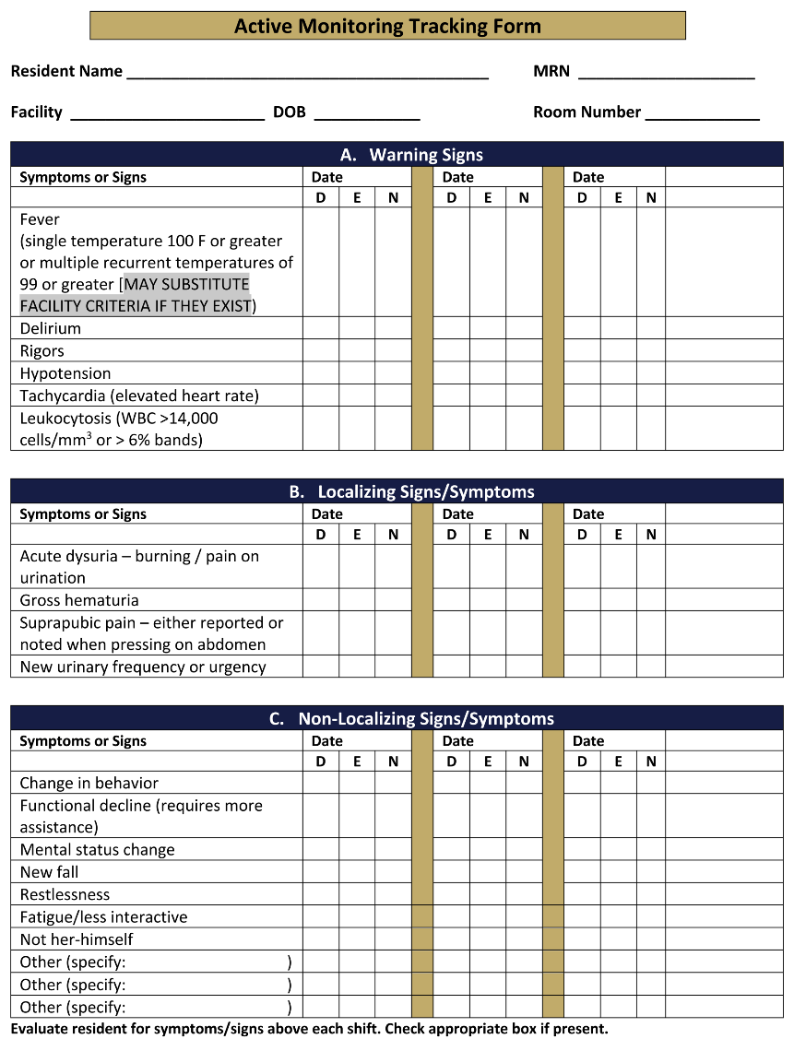
What is an Active Monitoring
Temporary Care Plan*
* Nace DA, Drinka PJ, Crnich CJ. Clinical uncertainties in the approach to LTC residents with possible UTI. J Am Med Dir Assoc 2014; 15(2): 133-9. PMID: 24461240
2 Nace et al. J Am Med Dir Assoc 2014

Slide 21
Resident Change in Condition
Yes
Empiric Therapy for UTI
1
Localizing Urinary Signs/Symptoms?
Yes
Obtain
UA & UCx
Warning
Signs?
No
Target Therapy Based on UCx
No – consider withholding treatment until UCx results back
2
Yes
Non-Urinary Signs/Symptoms?
If a resident has:
No localizing urinary symptoms AND
No warning signs (see later) AND
No evidence of infection elsewhere AND
Improves after 48 hours of observation THEN
DON’T PRESCRIBE ANY ANTIBIOTICS
Work-up/Treat Other Cause
No
3
Warning Signs?
Yes
Obtain
UA & UCx
Empiric Therapy for UTI
Target Therapy Based on UCx
No
No Change / Worse
4
Resident Status after 48h of Observation?
Non-Urinary
Signs/Symptoms?
Yes
Work-up/Treat Other Cause
Improved
No
No Antibiotic
Necessary
Obtain
UA & Ucx
Consider Empiric Rx of UTI
Target Therapy Based on Cx
1 Crnich and Drinka. Ann Long Term Care 2014

Slide 22
Resident Change in Condition
If a resident has:
No localizing urinary symptoms AND
No warning signs (see later) AND
No evidence of infection elsewhere AND
Does not improve after 48 hours of observation THEN
Look for other causes again.
If no other causes found then consider treatment for UTI.
Yes
Empiric Therapy for UTI
1
Localizing Urinary Signs/Symptoms?
Yes
Obtain
UA & UCx
Warning
Signs?
No
Target Therapy Based on UCx
No – consider withholding treatment until UCx results back
2
Non-Urinary Signs/Symptoms?
Yes
Work-up/Treat Other Cause
No
3
Warning Signs?
Yes
Obtain
UA & UCx
Empiric Therapy for UTI
Target Therapy Based on UCx
No
No Change / Worse
4
Resident Status after 48h of Observation?
Non-Urinary
Signs/Symptoms?
Yes
Work-up/Treat Other Cause
Improved
No
No Antibiotic
Necessary
Obtain
UA & Ucx
Consider Empiric Rx of UTI
Target Therapy Based on Cx
1 Crnich and Drinka. Ann Long Term Care 2014

