Slide 1
When and How to Treat UTI
Section 2: How to Treat
On Behalf of the
Wisconsin Healthcare-Associated (HAIs) in Long Term Care Coalition

Slide 2


UTI Toolkit – Module 4b
Narration by:
Christopher J. Crnich, MD PhD
Chief of Medicine, William S. Middleton Memorial VA Hospital
Associate Professor of Medicine, University of Wisconsin-Madison
Content developed in partnership with the Wisconsin
Healthcare-Associated Infections in Long-Term Care Coalition
Funding for this project was provided by the Wisconsin Partnership Program at the UW School of Medicine and Public Health

Slide 3
There are Five Moments of
Antibiotic Decision-Making
1
Should I Test?
2
Should I Treat?
3
How do I Treat?
4
Should I Change/Modify?
5
How Long do I Treat?

Slide 4
How to Treat is a little more complex…
How to Treat
Renal function*
Allergies & Current Medications
Prior Treatment & Cultures
Facility Formulary & Resistance Patterns
Current Culture Results
Simple UTI (Cystitis) OR Complicated UTI?
While treatment should not be the same for every resident, …
… there are certain principles that should be followed
*Age, weight, height, sex, race

Slide 5
How To Treat
How to Treat
Renal function*
Allergies & Current Medications
Prior Treatment & Cultures
Facility Formulary & Resistance Patterns
Current Culture Results
Simple UTI (Cystitis) OR Complicated UTI?
Basic Principles
Always get cultures before treating
Nitrofurantoin and TMP/SMX are preferred over fluoroquinolones
Use the shortest duration of therapy possible
*Age, weight, height, sex, race

Slide 6
How To Treat
How to Treat
Renal function*
Allergies & Current Medications
Prior Treatment & Cultures
Facility Formulary & Resistance Patterns
Current Culture Results
Simple UTI (Cystitis) OR Complicated UTI?
Basic Principles
Always get cultures before treating
Nitrofurantoin and TMP/SMX are preferred over fluoroquinolones
Use the shortest duration of therapy possible
*Age, weight, height, sex, race

Slide 7
How To Treat
How to Treat
Renal function*
Allergies & Current Medications
Prior Treatment & Cultures
Facility Formulary & Resistance Patterns
Current Culture Results
Simple UTI (Cystitis) OR Complicated UTI?
Basic Principles
Always get cultures before treating
Nitrofurantoin and TMP/SMX are preferred over fluoroquinolones
Use the shortest duration of therapy possible
*Age, weight, height, sex, race

Slide 8
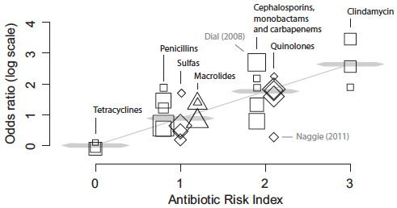
Why Avoid Fluoroquinolones?
High rates of resistance among bacteria that cause UTI
Major driver of infection with Clostridioides difficile (Figure) ²
High rates of adverse effects (Table) ^{3,4}
FDA → do not use for treatment of common infections ⁵
Adverse Effects of Fluoroquinolones
Gastrointestinal | Nausea and vomiting
CNS | Headaches, dizziness, sleep disturbances
Musculoskeletal | Tendon rupture, arthropathy
Cardiovascular | QT prolongation, aortic aneurysms
Skin | Rash (maculopapular)
3 Brown et al. Antimicrob Agents Chemother 2013
4 Tandan et al. Int J Antimicrob Agents 2018
5 Daneman et al. BMJ 2015
6 FDA Drug Safety Communication 2016

Slide 9
How To Treat
How to Treat
Renal function*
Allergies & Current Medications
Prior Treatment & Cultures
Facility Formulary & Resistance Patterns
Current Culture Results
Simple UTI (Cystitis) OR Complicated UTI?
Basic Principles
Always get cultures before treating
Nitrofurantoin and TMP/SMX are preferred over fluoroquinolones
Use the shortest duration of therapy possible
*Age, weight, height, sex, race

Slide 10
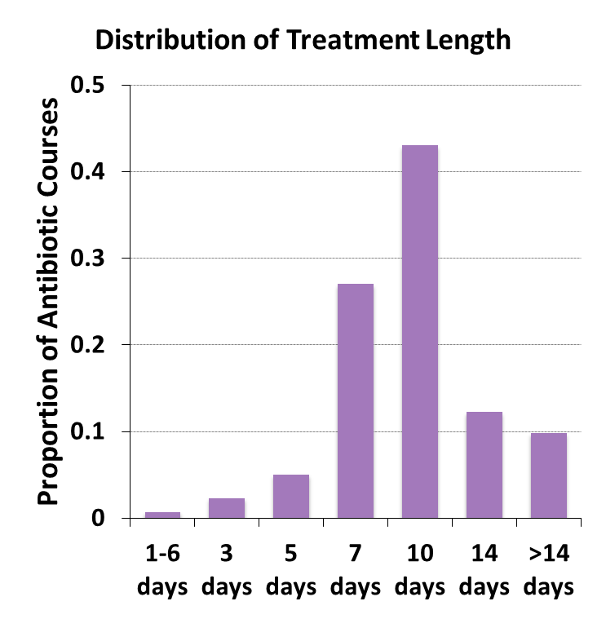
Frequency and Consequences of Long Durations of UTI Treatment
Study of treated UTI episodes among 40,000 older male Veterans (65% of patients received >7d of therapy [Figure])
Early recurrence (<30 days after completing treatment) was the same in patients treated for <7d or >7d (3.9% vs. 4.2%, P = 0.55)
Late recurrence (≥30 days after completing treatment) was higher in patients treated for >7d (OR 1.2; 95% CI 1.1 – 1.3)
Infection with C. difficile was higher* in patients treated for >7d (OR 1.4; 95% CI 1.0 – 2.1)
7 Drekonja et al. JAMA Intern Med 2013
* Statistivall significant on univariate but not on multivariate analyses

Slide 11
What Am I Treating?
* Signs of Complication ⁷
UTI Suspected
Fever
Flank pain
Rigor/chills
Urinary catheter
Hypotension/Tachycardia
Elevated WBC
Uncomplicated UTI (Cystitis)
Complicated UTI or Upper Tract Infection (Pyelonephritis)
  Urethral symptoms (dysuria, frequency) are predominant
  Signs of complication* are absent
  Can often wait for culture results before starting treatment
  Females can often be treated for less than 7 days depending on the agent used
  Signs of complication* are present
  Don’t wait for culture results if resident has high fever, rigors or hypotension/tachycardia
  Use agents that provide high blood and urine levels (IV agents, TMP/SMX, and fluoroquinolones)
8 Nace et al. JAMDA 2018

Slide 12
Empiric Treatment of Cystitis
Females
Preference | Estimated Creatinine Clearance (eCrCl)
 | >30 | 15 – 30 | <15
First | Nitrofurantoin 100mg BID (5 days) OR TMP/SMX 160/800 BID (3 days) | TMP/SMX 80/400 BID (3 days) | Ciprofloxacin 250mg BID (3 days)
Second | Fosfomycin 3gm (Once) Re-dose on day #3 if extending treatment >3d | Fosfomycin 3gm (Once) Re-dose on day #3 if extending treatment >3d | Fosfomycin 3gm (Once) Re-dose on day #3 if extending treatment >3d
Third | Ciprofloxacin 250mg BID (3 days) | Ciprofloxacin 250mg BID (3 days) | ---
9 Nace et al. J Am Geriatr Soc 2018
10 University of Nebraska – Urinary Tract Infection and Asymptomatic Bacteriuria Guideline

Slide 13
Empiric Treatment of Cystitis
Males
Preference | Estimated Creatinine Clearance (eCrCl)
 | >30 | 15 – 30 | <15
First | Nitrofurantoin 100mg BID (7 days) OR TMP/SMX 160/800 BID (7 days) | TMP/SMX 80/400 BID (7 days) | Ciprofloxacin 250mg BID (7 days)
Second | Fosfomycin 3gm (Dose on day #1, #3, #5) | Fosfomycin 3gm (Dose on day #1, #3, #5) | Fosfomycin 3gm (Dose on day #1, #3, #5)
Third | Ciprofloxacin 250mg BID (7 days) | Ciprofloxacin 250mg BID (7 days) | ---
9 Nace et al. J Am Geriatr Soc 2018
10 University of Nebraska – Urinary Tract Infection and Asymptomatic Bacteriuria Guideline

Slide 14
What About Amoxicillin & Cephalexin?
Primary rates of resistance to amoxicillin and cephalexin are too high to recommend their use during the empiric phase of treatment.
It is reasonable to use these agents as alternatives to fluoroquinolones once culture results are back and show these agents are active
Treatment courses using these drugs need to be at least 7 days due to lower urinary drug levels when compared to TMP/SMX and fluoroquinolones

Slide 15
Empiric Treatment of Complicated UTI. It’s “Complicated”
Consider transfer if high fever, tachycardia or hypotension.
  If concerned about sepsis: obtain a urine culture and administer a single 1gm dose of ceftriaxone (IV/IM) or ertapenem (IV/IM) prior to transfer.
Choice of empiric therapy should be based on resident’s previous culture results AND previous antibiotic treatment AND facility resistance patterns.
  It may be necessary to administer IV/IM therapy until urine culture results are back before using an oral agent.
Most residents can be treated for ~7 days of therapy but it may be appropriate to extend therapy if symptoms are severe at onset or if resident not back to baseline after 72 hours of effective therapy.
  Effective therapy means urine cultures are positive for an organism that is susceptible to the antibiotic chosen empirically
  Consider alternative causes if resident not improving by 48 hours if cultures show drug is active or if cultures are negative.
10 University of Nebraska – Urinary Tract Infection and Asymptomatic Bacteriuria Guideline
11 Gupta et al. Clin Infect Dis 2011

Slide 16
Empiric Treatment of Complicated UTI
Hemodynamically Stable & Low Concern for Resistance*
Preference | Estimated Creatinine Clearance (eCrCl)
 | >30 | 15 – 30 | <15
First | TMP/SMX 160/800 BID (7 days) | TMP/SMX 80/400 BID (7 days) | Ciprofloxacin 250mg BID (5 days)
Second | Cefpodoxime 200mg PO BID (7 days) OR Cefuroxime 500mg PO BID (7 days) | Cefpodoxime 200mg PO QD (7 days) OR Cefuroxime 500mg PO QD (7 days) | Cefpodoxime 200mg PO QD (7 days) OR Cefuroxime 500mg PO Q48○ (Admin on days 1, 3, 5, & 7)
Third | Ciprofloxacin 500mg BID (5 days) | Ciprofloxacin 250mg BID (5 days) | ---
Extend therapy if symptoms severe at onset or if resident is not back to baseline after 72 hours of therapy: Cipro (5d → 7d); TMP/SMX (7d → 10d); Cefpodoxime/Cefuroxime (7d → 10d)
* No culture results with resistance to TMP/SMX and/or ciprofloxacin or treatment with these agents in the prior 3 months. Resistance rates to TMP/SMX and/or ciprofloxacin <20% in facility.
10 University of Nebraska – Urinary Tract Infection and Asymptomatic Bacteriuria Guideline
12 Hooten et al. Clin Infect Dis 2011

Slide 17
Empiric Treatment of Complicated UTI
Resident Ill (but not enough to hospitalize) and/or
Concern for TMP/SMX and/or Ciprofloxacin Resistance*
Culture Results Unknown**
Culture Results & Susceptibilities Known**
First-Line
Ceftriaxone 1gm q24
Second-Line
Gentamicin 5 mg/kg q24
+/-
Vancomycin 1gm q12
Non-Pseudomonal Gram-Negative (e.g. E. coli)
1 | TMP/SMX
2 | Cefuroxime/Cefpodoxime
4 | Ciprofloxacin
Pseudomonas
1 | Ciprofloxacin
2 | Levofloxacin
* Culture results with resistance to TMP/SMX and/or ciprofloxacin or treatment with these agents in the prior 3 months. Resistance rates to TMP/SMX and/or ciprofloxacin ≥20% in facility.
** Refer to Johns Hopkins Antibiotic Guide or Sanford Guide for exact dosing in residents with impaired renal
function

Slide 18
Empiric Treatment of Complicated UTI
Resident Ill (but not enough to hospitalize) and/or
Concern for TMP/SMX and/or Ciprofloxacin Resistance*
Culture Results Unknown**
Culture Results & Susceptibilities Known**
First-Line
Ceftriaxone 1gm q24
Second-Line
Gentamicin 5 mg/kg q24
+/-
Vancomycin 1gm q12
Staphylococcus sp.
1 | TMP/SMX (if methicillin-resistant)
2 | Cephalexin (if methicillin-susceptible)
Enterococcus sp.
1 | Amoxicillin
2 | Doxycycline
* Culture results with resistance to TMP/SMX and/or ciprofloxacin or treatment with these agents in the prior 3 months. Resistance rates to TMP/SMX and/or ciprofloxacin ≥20% in facility.
** Refer to Johns Hopkins Antibiotic Guide or Sanford Guide for exact dosing in residents with impaired renal
function

