Slide 1
When and How to Treat UTI
Section 3: Antibiotic Timeout
On Behalf of the
Wisconsin Healthcare-Associated (HAIs) in Long Term Care Coalition

Slide 2
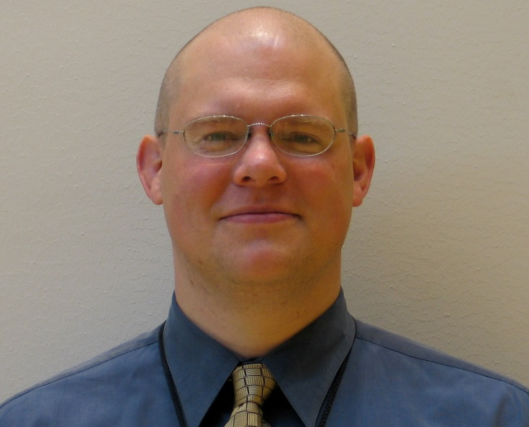

UTI Toolkit – Module 4c
Narration by:
Christopher J. Crnich, MD PhD
Chief of Medicine, William S. Middleton Memorial VA Hospital
Associate Professor of Medicine, University of Wisconsin-Madison
Content developed in partnership with the Wisconsin
Healthcare-Associated Infections in Long-Term Care Coalition
Funding for this project was provided by the Wisconsin Partnership Program at the UW School of Medicine and Public Health

Slide 3
There are Five Moments of
Antibiotic Decision-Making
1
Should I Test?
2
Should I Treat?
3
How do I Treat?
4
Should I Change/Modify?
5
How Long do I Treat?

Slide 4
Opportunities to Modify Existing Antibiotic Therapy in NHs
Subject is being treated for UTI in a nursing home or emergency department setting
Record review study of 364 residents being treated for UTI in 5 Wisconsin NHs
2/3rds of the treatment courses amenable to some form or modification
Yes
Subject does not meet McGeer or Loeb criteria
OR
Urine analysis and/or urine culture are negative
No
Yes
Discontinue Antibiotics.
Continue Antibiotics
Duration of effective antibiotic therapy is > 7 days
Subject receiving a fluoroquinolone
AND
Urine culture shows susceptibility to a narrow-spectrum alternative
Yes
No
Yes
No
Shorten treatment duration
Treatment duration is appropriate
Change to appropriate narrow-spectrum antibiotics
No change needed
12 Hossin et al. IDWeek 2017

Slide 5
What is an Antibiotic Timeout?
A scheduled time for clinicians to re-evaluate the appropriateness of their resident’s antibiotics.
Typically performed 48-72 after starting antibiotic therapy and culture results (if obtained) are back.
The CDC recommends this be done with every prescription, regardless of treatment location.
Focus on the 3 “S’s” (Stop, Spectrum, Shorten)
13 Lee et al. Ann Intern Med 2014
14 Jones et al. J Biomed Inform 2017

Slide 6
The 3 “Ss” of the Antibiotic Timeout
Stop
Spectrum
Shorten

Slide 7
The 3 “Ss” of the Antibiotic Timeout
Stop
If another explanation for resident change-in-condition identified
If urine culture is negative
Spectrum
Shorten

Slide 8
The 3 “Ss” of the Antibiotic Timeout
Stop
Resistance
Change to an antibiotic with activity against organism recovered
Spectrum
Shorten

Slide 9
The 3 “Ss” of the Antibiotic Timeout
Stop
Resistance
Change to an antibiotic with activity against organism recovered
Spectrum
De-escalate to narrow spectrum alternative (e.g., NFT, TMP/SMX)
No Resistance
Shorten

Slide 10
The 3 “Ss” of the Antibiotic Timeout
Stop
Spectrum
Uncomplicated
Females: 3-7 days
Males: 7 days
Shorten

Slide 11
The 3 “Ss” of the Antibiotic Timeout
Stop
Spectrum
Uncomplicated
Females: 3-7 days
Males: 7 days
Shorten
TMP/SMX: 7-10 days
Beta-lactams: 7-10 days
Fluoroquinolones: 5-7 days
Complicated

Slide 12
The 3 “Ss” of the Antibiotic Timeout
Stop
If another explanation for resident change-in-condition identified
If urine culture is negative
Resistance
Change to an antibiotic with activity against organism recovered
Spectrum
De-escalate to narrow spectrum alternative (e.g., NFT, TMP/SMX)
No Resistance
Uncomplicated
Females: 3-7 days
Males: 7 days
Shorten
TMP/SMX: 7-10 days
Beta-lactams: 7-10 days
Fluoroquinolones: 5-7 days
Complicated

