Slide 1
When and How to Treat UTI
Section 4: The Role of the Pharmacist

Slide 2
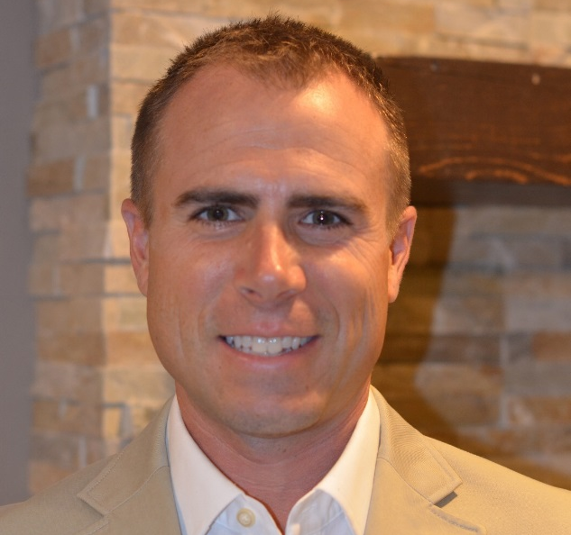

UTI Toolkit – Module 4d
Narration by:
Matthew Palmer B.S., PharmD, BCGP
Wisconsin Healthcare-Associated Infections in Long-Term Care Coalition
Regional Clinical Manager, AlixaRx
Content developed in partnership with the Wisconsin
Healthcare-Associated Infections in Long-Term Care Coalition
Funding for this project was provided by the Wisconsin Partnership Program at the UW School of Medicine and Public Health

Slide 3
The Collaborative Role of the Pharmacist in Antibiotic Stewardship
“Work with a consultant pharmacist who has received specialized infectious diseases or antibiotic stewardship training”
14 CDC The Core Elements of Antibiotic Stewardship for Nursing Homes 2015

Slide 4
Details, details,…
Pharmacist involvement real time
Current serum creatinine, weight, height
Current active medications list
Allergy history
Lab microbiology report availability
Pharmacist/physician order attestation signature
Physician participation and acceptance

Slide 5
Wisconsin Act 294 (2013) – Amendment to Wisconsin Statutes
49.498 (2) (a) 3. A (nursing home) quality assessment and assurance committee … may establish written guidelines or procedures for making therapeutic alternate drug selections … if the committee members include a pharmacist.
Section 4. 450.033 of the statutes is created to read:
450.033 Services delegated by physician. A pharmacist may perform any patient care service delegated to the pharmacist by a physician, as defined in s. 448.01 (5).
15 Wisconsin Statutes: available for review at - https://docs.legis.wisconsin.gov/2013/related/acts/294

Slide 6
Practical Matters of WI Act 294
There must be a facility policy
There must be a collaborative practice agreement between a physician and/or a PA
There must be a physician signature for Medicare payment for lab monitoring tests
NPs not included

Slide 7
Opportunities
Allow pharmacist to
  Order labs
  Dose adjust based on renal function
  Decrease duration
  Discontinue antibiotic at 48 hr. timeout
  De-escalate or change antibiotic at 48 hr. timeout
Create facility policy to contact pharmacist at 48 hr. timeout for recommendations
Create facility policy to contact physician at 48 hr. timeout if resident not responding to therapy.

