Slide 1
Preparing for Successful Organizational Change

Slide 2
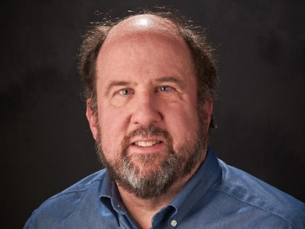

UTI Toolkit – Module 5
Narration by:
Jay Ford, PhD, FACHE, LFHIMSS
Assistant Professor
School of Pharmacy, University of Wisconsin-Madison
Content developed in partnership with the Wisconsin
Healthcare-Associated Infections in Long-Term Care Coalition
Funding for this project was provided by the Wisconsin Partnership Program at the UW School of Medicine and Public Health

Slide 3
Objectives
Understand quality assurance, quality control and quality improvement
Identify differences between QA and QI
Understand the role of CQI in organizational change
Discuss the coaching sequence for organizational change
Identify the importance of a team based approach to organizational change

Slide 4
What is Quality?
Quality is the extent to which patient care programs and services increase the likelihood of desired not undesired patient outcomes based on existing knowledge.
According to Institute of Medicine (IOM), quality health care should be:
    Safe
    Effective
    Patient-centered
    Timely
    Efficient
    Equitable

Slide 5
Areas of Quality Focus
Quality Assurance
Quality Control
Quality Improvement

Slide 6
Quality Assurance
Quality assurance (QA): set of activities utilized to ensure the processes used lead to products that meet predetermined standards of quality
  QA is a reactionary approach to quality improvement
  QA focuses on why an error occurred and often involves a retrospective review of the process

Slide 7
Quality Control
Quality control (QC): set of testing activities used to confirm the components and final products meet predetermined requirements
QC is derived from manufacturing and is intended to block the release of “defective” products.
QC often involved testing a sample of the product or process to confirm that it “contain” any errors.
Medication dispensing: confirm right drug, right dose, right directions, right patient before dispensing

Slide 8
Quality Improvement
Quality improvement is the systematic approach to increase desired outcomes and reduce or eliminate undesired outcomes.
Elements include:
  Identify areas for improvement
  Devise mechanism to evaluate the impact of change
  Quickly implement changes or innovations, often using PDSA rapid cycle change
  Understand the benefits
  Share lessons learned with others

Slide 9
Differences between QA and QI
Quality Assurance | Quality Improvement
Conforming to standards | Improved performance
Relies on inspection of the final product, the service, or a step in the process | Ongoing/occurs repeatedly over time
Focuses on what went wrong with a process or product | Focuses on systems and their interactions
May involve determining fault after something goes wrong (punitive) | Involves fixing or improving processes (nonjudgmental)
Individual assignment or departmental function | Interdisciplinary function
Typically retrospective in nature | Typically prospective in nature
Usually completed to avoid a problem or address a problem | Can be completed without identifying problems
Table 14-3 Differences Between Quality Assurance and Quality Improvement

Slide 10
Deming’s CQI philosophy
Decreased costs
Increased productivity
Fewer errors
Reduce re-work
Less delays
Better resource use
Long term strategy to improve process and products and customer satisfaction
Strong market
Stay in business
Identify growth opportunities

Slide 11
Continuous Quality Improvement
Continuous quality improvement (CQI): the ongoing or repeated enhancements of a product or service
  Assumes most things can be improved
  Emphasizes the organization, systems, and processes
  The focus is not correcting individual errors after they occur
  Continually and incrementally improving individual steps within processes that lead to variation and errors
  Requires objective data to analyze and improve processes

Slide 12
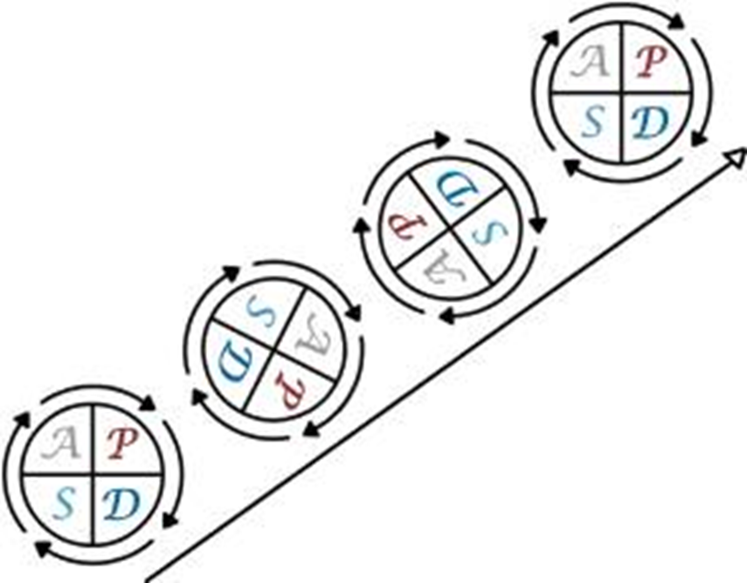
Model for Improvement
What are we trying to accomplish?
How will we know that a change is an improvement?
What changes can we make that will result in an improvement?
Plan
Do
Study
Act

Slide 13
Core Coaching Principles: Sequence
Change and quality improvement projects require a 5 step sequence:
Engage
Assess
Plan
Work
Evaluate

Slide 14
Core Coaching Principles: Sequence
Engage
Assess
Plan
Work
Evaluate
Engagement Phase:
Establish the initial relationship with representatives within the organization who are leading change and executive sponsors.
Explore key questions to create a general project compass heading.
Cultivate awareness regarding the return on investment (ROI) of the project.

Slide 15

Core Coaching Principles: Retreat
Understand environment, our organization, and its opportunities for improvement
  Why are we doing what we are doing?
  Where do we need to go?
  How can we get there?
  How can we improve?
  What are the risks, challenges, and opportunities that we need to address?
Safely find a path forward by regrouping and recharging

Slide 16
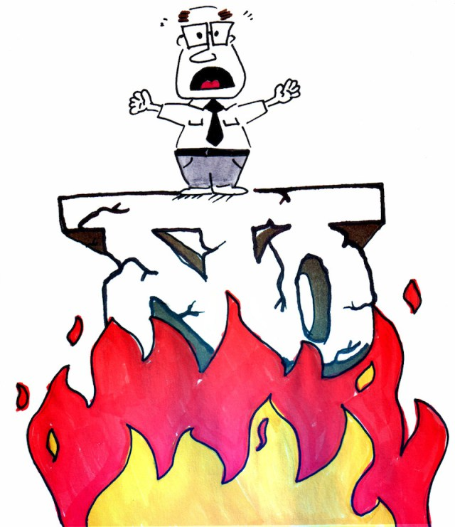
Core Coaching Principles: Urgency
Urgency requires a
“Burning Platform”.

Slide 17
How can we increase a felt sense of urgency?
Urgency for change
Executive sponsorship
Business case awareness
A Sense of Urgency, John Kotter
1. Bring the outside in: external opportunities, vs. “we know best”
2. Behave with urgency every day: Walk the talk and lead by example.
3. Find opportunity in crises: Leveraged the crisis to break through complacency.
4. Deal with the No-Nos: Address those who hinder change.
ROI

Slide 18
Core Coaching Principles: Sequence
Engage
Assess
Plan
Work
Evaluate
Assessment Phase:
Use tools to understand the organizational environment, strengths and challenges.
Dialogue to establish clear stretch goals.

Slide 19
Core Coaching Principles: Sequence
Engage
Assess
Plan
Work
Evaluate
Planning Phase:
Plan the details of the change/ project.
Define strategies and tools to measure progress toward the chosen goals.
Dedicate time, people and resources to the project.
Develop a project timeline.
Cultivate commitment among team members.

Slide 20

Core Coaching Principles: Teams
If you want to go fast,
go alone…
If you want to go far,
go together.
African proverb

Slide 21

Team as Verb
To Team…the act of Teaming…
To put together in order to do something or to achieve a particular effect.
…

Slide 22
Traits of Strong Teams
Learn and adapt quickly to change.
Communicate and share ideas, successes, challenges.
Diligently focus on the details and fundamentals of success.
Have diverse experiences, skills, and ideas.
Have a clearly articulated common mission/ goal.
Trust each other to perform with commitment.
Creative
JOY
Energy
1
Agility
2
Share
3 Details
6
Trust
4 Diversity
5 Mission

Slide 23

Change Teams
Executive Sponsor
Change Leader
Data Coordinator
Team members
Sustain Leader

Slide 24
Core Coaching Principles: Sequence
Engage
Assess
Plan
Work
Evaluate
High Impact
Low Doable
High Impact
High Doable
Planning Phase:
Consider projects that have high impact
Consider projects that are doable
Impact?
Low Impact
Low Doable
Low Impact
High Doable
Doable?

Slide 25
Core Coaching Principles: Sequence
Engage
Assess
Plan
Work
Evaluate
Work Phase:
Conduct regular meetings.
Adjust the implementation as needed based upon continuous dialogue.
Maintain team engagement in the face of competing priorities.
Avoid mission creep.
Maintain executive sponsorship and team alignment.
Monitor project data.

Slide 26
Core Coaching Principles: Sequence
Engage
Assess
Plan
Work
Evaluate
Evaluation & Sustain Phase:
Review of the data collected and the experience of the team.
Sustain activities that have produced desired results.
Establish new norms that change the culture.
Celebrate success.

Slide 27
Recommended Sequence:
Engage
Assess
Plan
Work
Evaluate
The all too common sequence:
Engage
Assess
Plan
Work
Evaluate

Slide 28
Continuous Improvement requires continuous action:
Engage
Assess
Plan
Work
Evaluate

Slide 29
Key Take Away Messages
Quality assurance and quality control are useful but continuous quality improvement is the most effective approach to successful organization change.
Change and quality improvement projects require a 5 step sequence.
Organizational change requires a team comprised of the right individuals.
Internal processes such as QAPI provide a framework for active CQI

