Slide 1
Coaching change through data driven team work
Jay Ford
University of Wisconsin-Madison

Slide 2
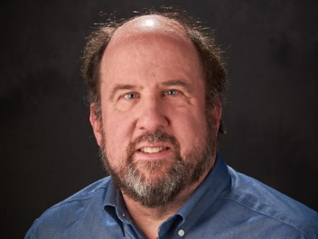

UTI Toolkit – Module 5
Narration by:
Jay Ford, PhD, FACHE, LFHIMSS
Assistant Professor
School of Pharmacy, University of Wisconsin-Madison
Content developed in partnership with the Wisconsin
Healthcare-Associated Infections in Long-Term Care Coalition
Funding for this project was provided by the Wisconsin Partnership Program at the UW School of Medicine and Public Health

Slide 3
Objectives
Learn why it is important to track data in organizational change.
Identify seven rules of the road related to using data to inform organizational change
Discuss elements of the seven rules of the road.

Slide 4
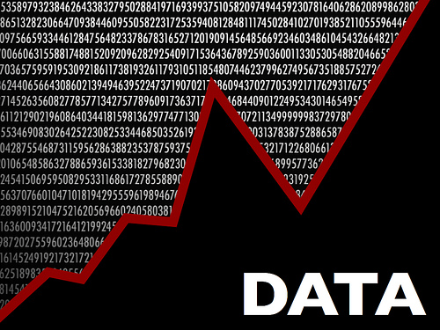
POWERFUL DATA, POWERFUL CHANGE:
Why is it important to track data?
If you want to change something, measure it.
Answers the question: “How will we know a change is an improvement?”
Measuring change enhances process improvement by
  Identifying which changes worked.
  Learning which changes resulted in improvement and
  Understanding which changes resulted in the most significant improvement

Slide 5
Using Data toward greater
Connectedness & Understanding
Connectedness
Wisdom
Understanding Principles
Knowledge
Understanding Patterns
INFO.
Understanding Relationships
DATA
Understanding

Slide 6
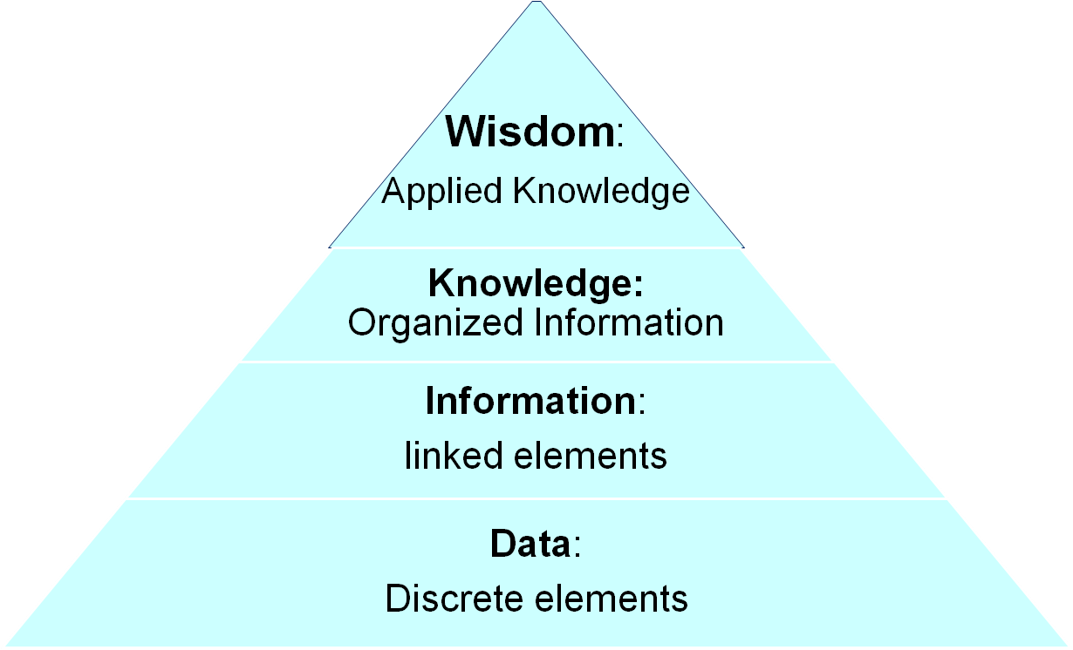
DIKW
Pyramid
Efforts to improve antibiotic prescribing resulted in reduced urine cultures and resulting antibiotic orders which resulted in improved patient care.
Based on review, 20% of urine cultures were unnecessary.
80 urine cultures ordered.
100 residents identified with suspected UTI symptoms.

Slide 7
7 Simple Rules of the Road
Define Measures
Collect Baseline Data
Report and chart progress
Define a clear aim
Consistent data collection
Avoid common pitfalls
Ask questions
Antibiotic start time: Time when ABX ordered to 1st dose administered.

Slide 8
7 Simple Rules of the Road
Define Measures
Collect Baseline Data
Report and chart progress
Define a clear aim
Consistent data collection
Avoid common pitfalls
Ask questions
Use agree upon definition
Defines clear starting point
Essential to successful change
Antibiotic start time: Time when ABX ordered to 1st dose administered.

Slide 9
7 Simple Rules of the Road
Define Measures
Collect Baseline Data
Report and chart progress
Define a clear aim
Consistent data collection
Avoid common pitfalls
Ask questions
No: ↓ Fluoroquinolone starts/1000 resident days by 40%
Yes: ↓ Fluoroquinolone starts/1000 resident days from 3.60 to 2.16
Use agree upon definition
Defines clear starting point
Essential to successful change
Antibiotic start time: Time when ABX ordered to 1st dose administered.

Slide 10
Rule 3: Establishing an aim
Be flexible
  Information suggests changing the aim, change it
  Aim is too ambitious, set a realistic aim that still challenges the agency to improve
  Aim is easily achieved, set a more ambitious aim that stretches the agency’s capacity to improve

Slide 11
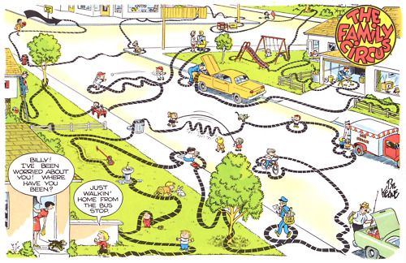
No Aim, No Basline =

Slide 12
7 Simple Rules of the Road
Define Measures
Collect Baseline Data
Report and chart progress
Define a clear aim
Consistent data collection
Avoid common pitfalls
Ask questions
No: ↓ Fluoroquinolone starts/1000 resident days by 40%
Yes: ↓ Fluoroquinolone starts/1000 resident days from 3.60 to 2.16
Use agree upon definition
Defines clear starting point
Essential to successful change
Establish a process to consistently collect and record data using agreed upon definition
Antibiotic start time: Time when ABX ordered to 1st dose administered.

Slide 13

7 Simple Rules of the Road
Define Measures
Collect Baseline Data
Report and chart progress
Define a clear aim
Consistent data collection
Avoid common pitfalls
Ask questions
No: ↓ Fluoroquinolone starts/1000 resident days by 40%
Yes: ↓ Fluoroquinolone starts/1000 resident days from 3.60 to 2.16
Stay out of the Quicksand
Don’t collect too much data
Don’t focus on too many measures
Don’t get trapped in analysis paralysis
Use agree upon definition
Defines clear starting point
Essential to successful change
Establish a process to consistently collect and record data using agreed upon definition
Antibiotic start time: Time when ABX ordered to 1st dose administered.

Slide 14
7 Simple Rules of the Road
Define Measures
Collect Baseline Data
Report and chart progress
Define a clear aim
Consistent data collection
Avoid common pitfalls
Ask questions
No: ↓ Fluoroquinolone starts/1000 resident days by 40%
Yes: ↓ Fluoroquinolone starts/1000 resident days from 3.60 to 2.16
Stay out of the Quicksand
Don’t collect too much data
Don’t focus on too many measures
Don’t get trapped in analysis paralysis
Use agree upon definition
Defines clear starting point
Essential to successful change
Establish a process to consistently collect and record data using agreed upon definition
Antibiotic start time: Time when ABX ordered to 1st dose administered.

Slide 15
Rule 6: Report and Chart Progress
A Simple Axiom: One chart, one message
Charts can be used to:
  Highlight the baseline (pre-change) data
  Identify when a change was introduced
  Visually represent the impact of individual changes over time, and
  Inform your agency about sustaining change over time.

Slide 16
Guidance for Providing Feedback
Ensure staff has sufficient background and/or familiarity to adequately interpret data.
Display numbers so that others can understand them.
Interpret numbers to make the correct decisions based on them.
Relate the numbers to people getting better.
Link the numbers to success stories to motivate others towards improvement.

Slide 18
Use of trend lines can show how the data is changing

Slide 19
Often a Change in One Area will impact another

Slide 20
Providing Feedback: Questions to Consider
How will the measures be reported?
  Only to leadership
  Quality Assurance/Quality Improvement (QAPI) meeting
How often will the measures be reported and the charts updated?
What else – besides the measures on these simple line charts – should be reported?
  Information about process changes
  Changes in resident acuity
  Impact of staffing on outcomes

Slide 21
7 Simple Rules of the Road
Define Measures
Collect Baseline Data
Report and chart progress
Define a clear aim
Consistent data collection
Avoid common pitfalls
Ask questions
Do not accept results at face value
Do the results look right?
What is the data telling us?
Unsuccessful changes afford the opportunity to ask why?
No: ↓ Fluoroquinolone starts/1000 resident days by 40%
Yes: ↓ Fluoroquinolone starts/1000 resident days from 3.60 to 2.16
Stay out of the Quicksand
Don’t collect too much data
Don’t focus on too many measures
Don’t get trapped in analysis paralysis
Use agree upon definition
Defines clear starting point
Essential to successful change
Establish a process to consistently collect and record data using agreed upon definition
Antibiotic start time: Time when ABX ordered to 1st dose administered.

Slide 22
POWERFUL DATA, POWERFUL CHANGE:
Why is it important to track data?
If you want to change something, measure it.
Answers the question: “How will we know a change is an improvement?”
Measuring change enhances process improvement by
  Identifying which changes worked.
  Learning which changes resulted in improvement and
  Understanding which changes resulted in the most significant improvement

Slide 23
What did this module accomplish?
Learned the importance of data in organizational change.
Identified seven simple rules of the road for using data in organizational change
  Discussed the importance of defining measures and collecting data consistently based on the measure definition.
  Emphasized the importance of a clear aim that allows the organization to experience a real impact of change efforts
  Highlighted the importance of simple and focused feedback
  Identified the power of questions in exploring the impact of change.

